Slide 1
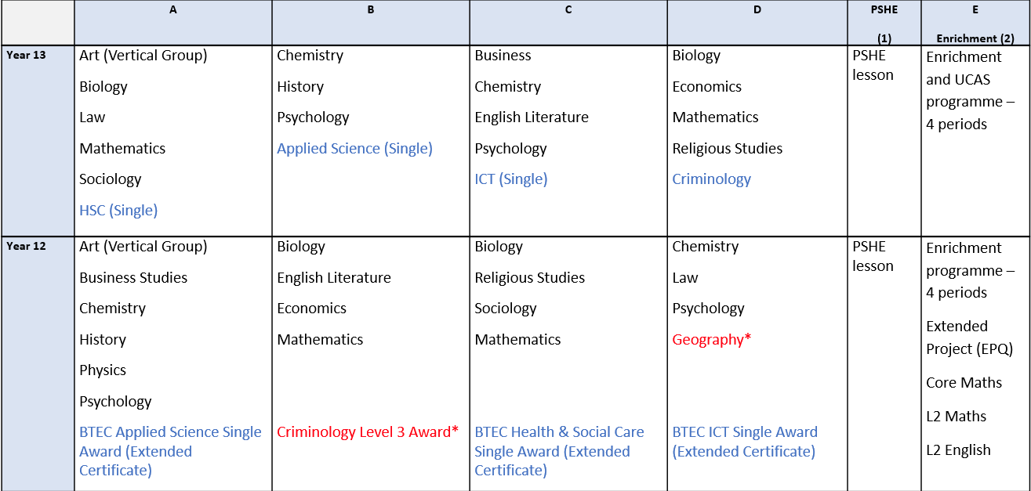
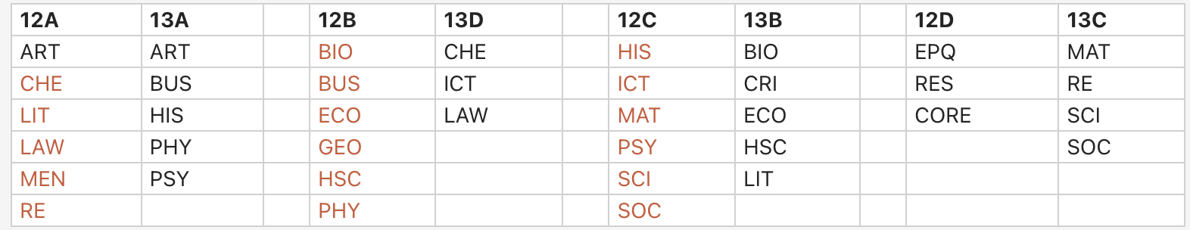
Sixth Form Blocks 2025
Sixth Form Blocks 2026/27

